Slide 1
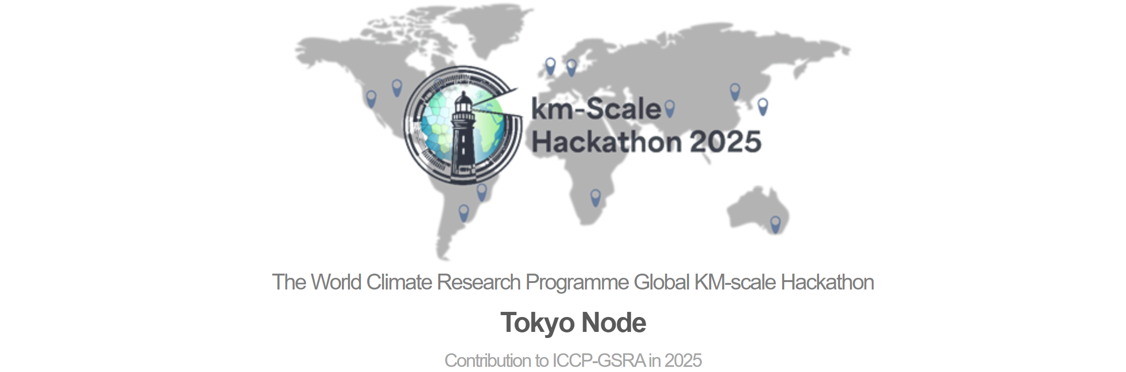

Data Handling & Visualization
Yen-Wei Li

Slide 2
Working with Healpix data
How can HEALPix-based data be effectively integrated into deep learning frameworks (e.g., CNNs or U-Nets)?
Data Preprocessing and Input Construction
Model Design
Model Training and Evaluation

Slide 3
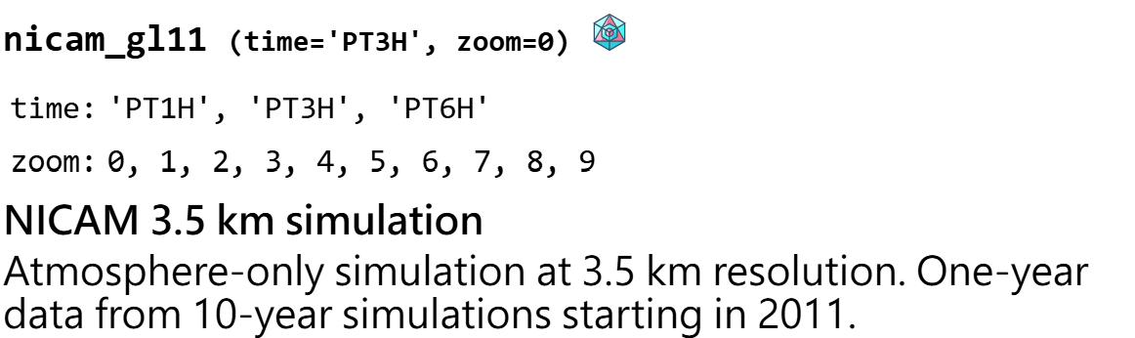
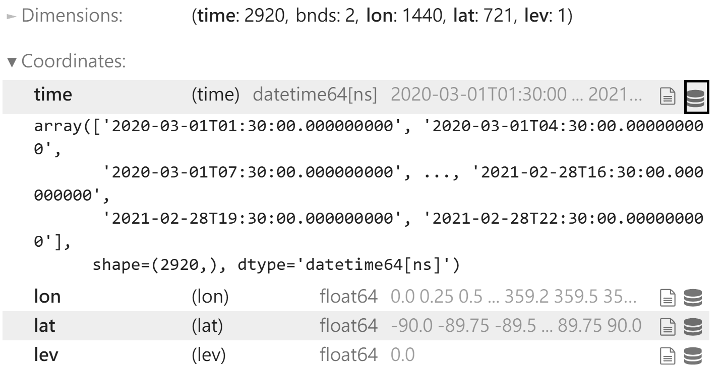
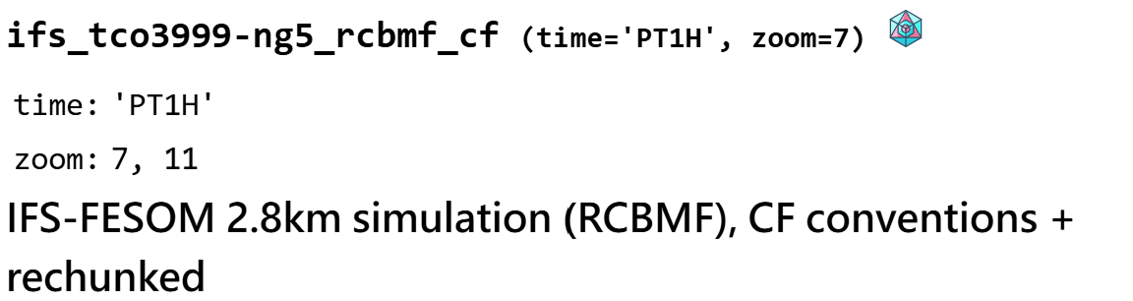
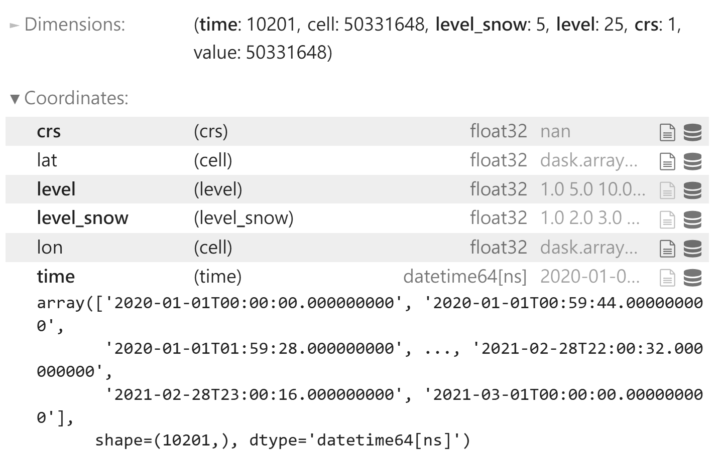
Data Preprocessing and Input Construction
Zoom Level = 9 ≈ 12 × 12 km
2020/03/01 ̴̴ 2021/02/28 (3hr)
Zoom Level = 11 ≈ 3 × 3 km
2020/01/01 ̴̴ 2021/03/01 (1hr)

Slide 4
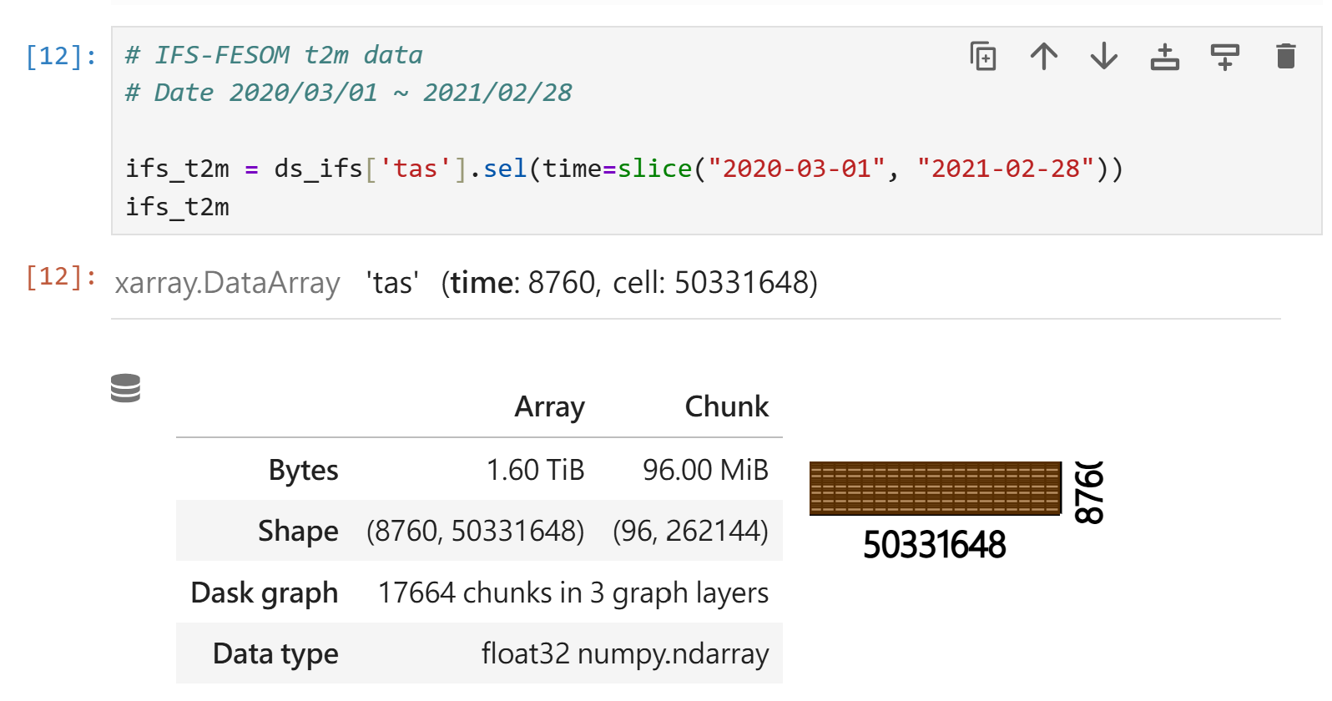
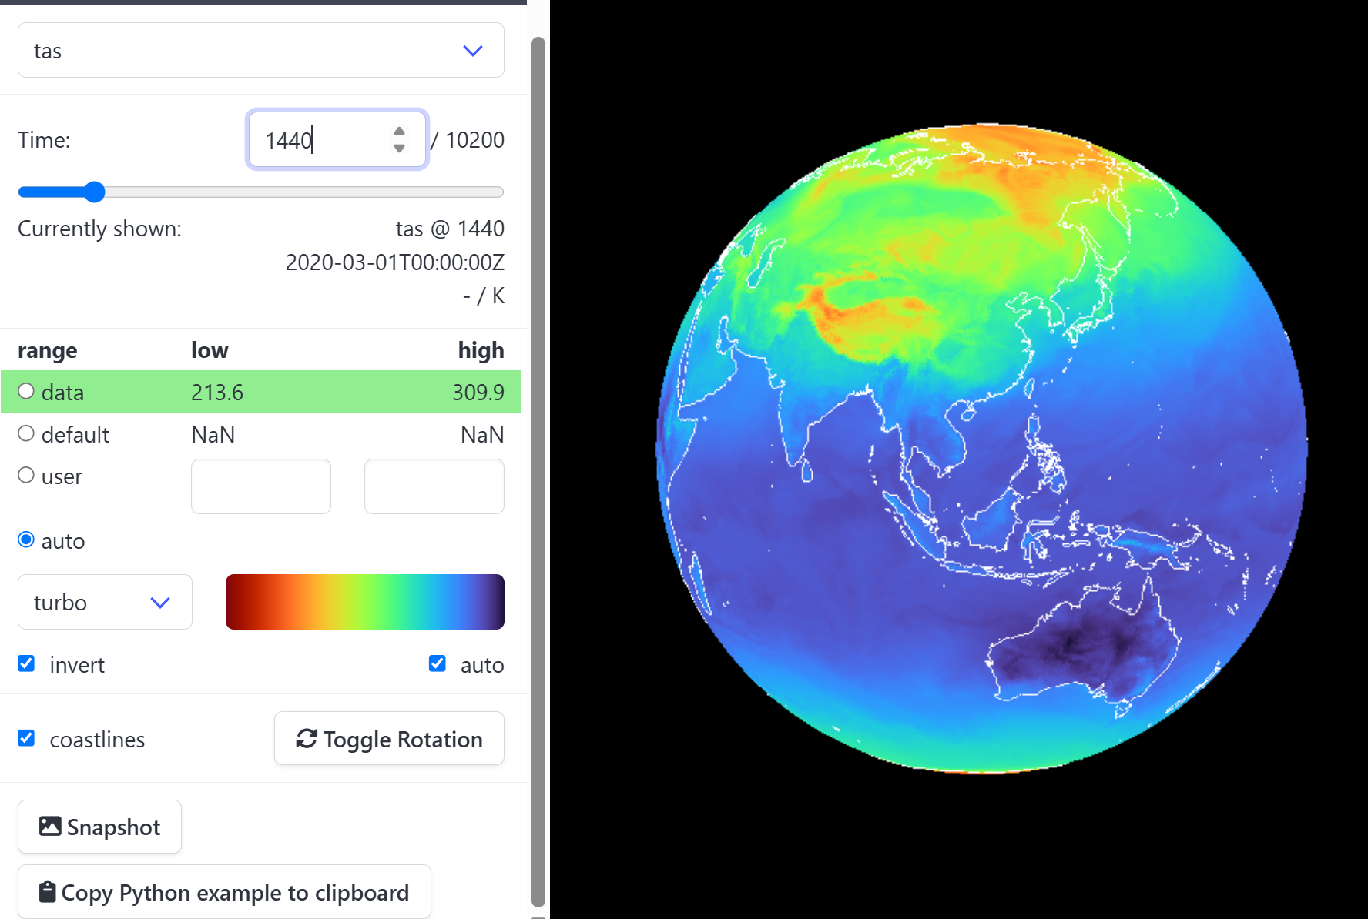
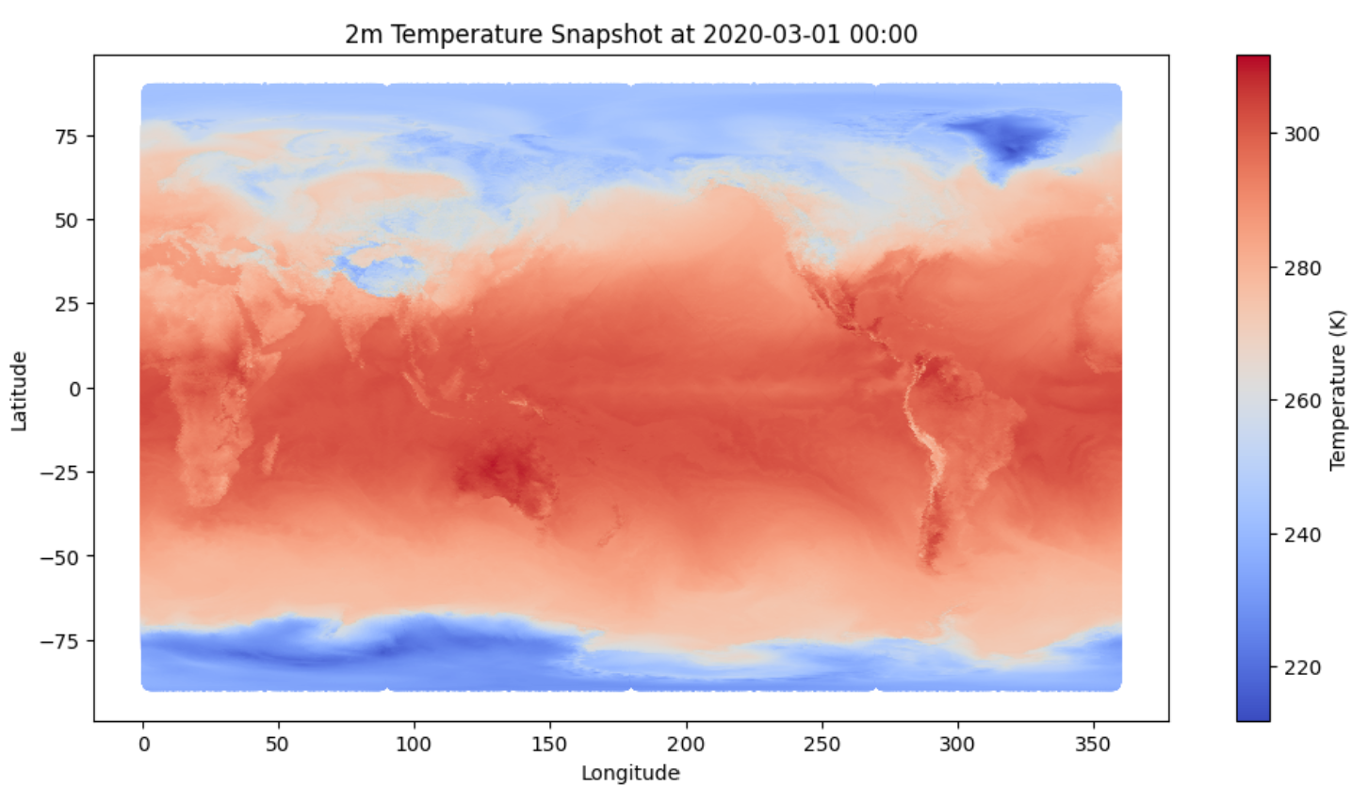
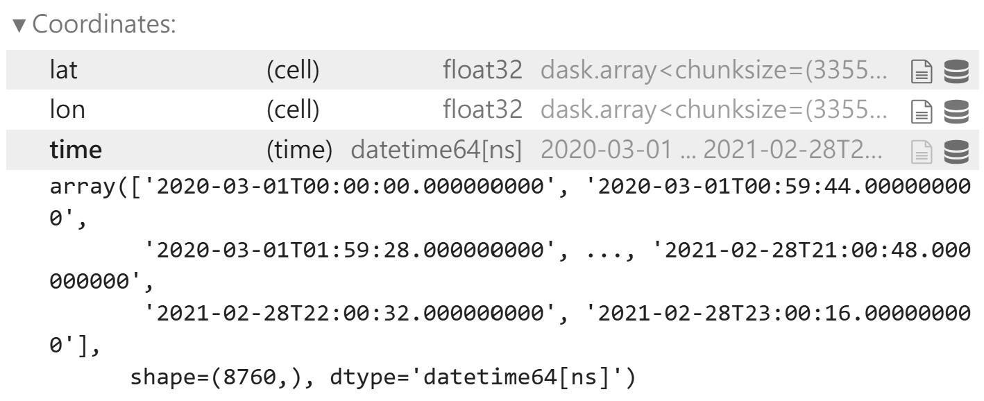
Check Input Data

Slide 5
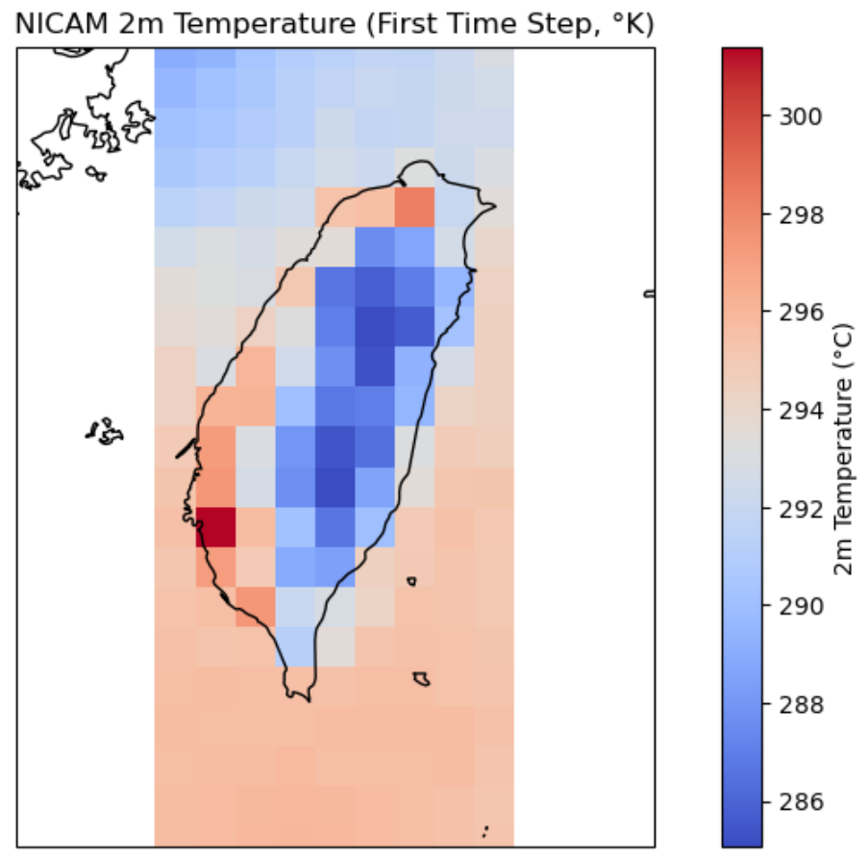
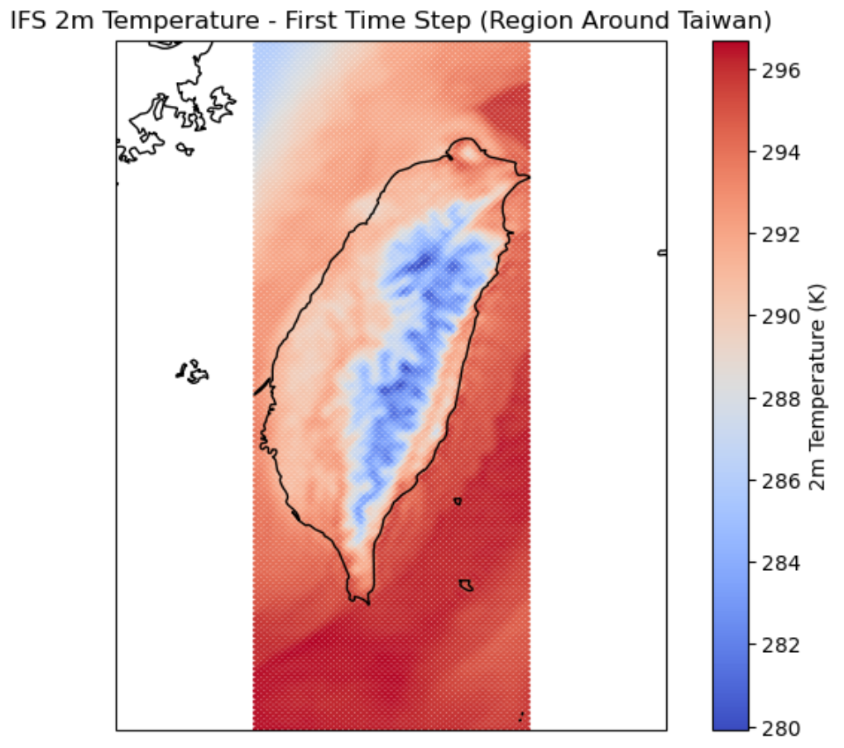
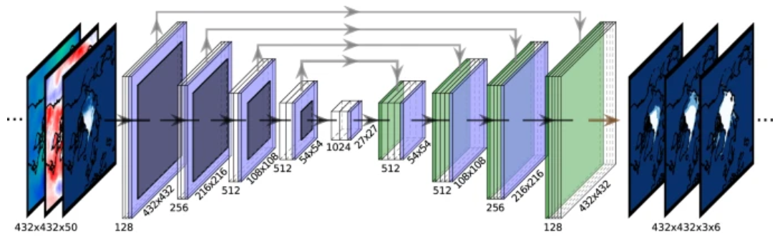
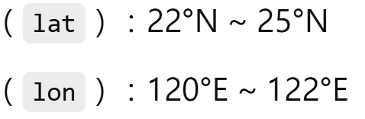
Model Design: CNN Downscaling
Model Design: CNN Downscaling
LR
HR
Convolutional Neural Network (CNN)

Slide 6
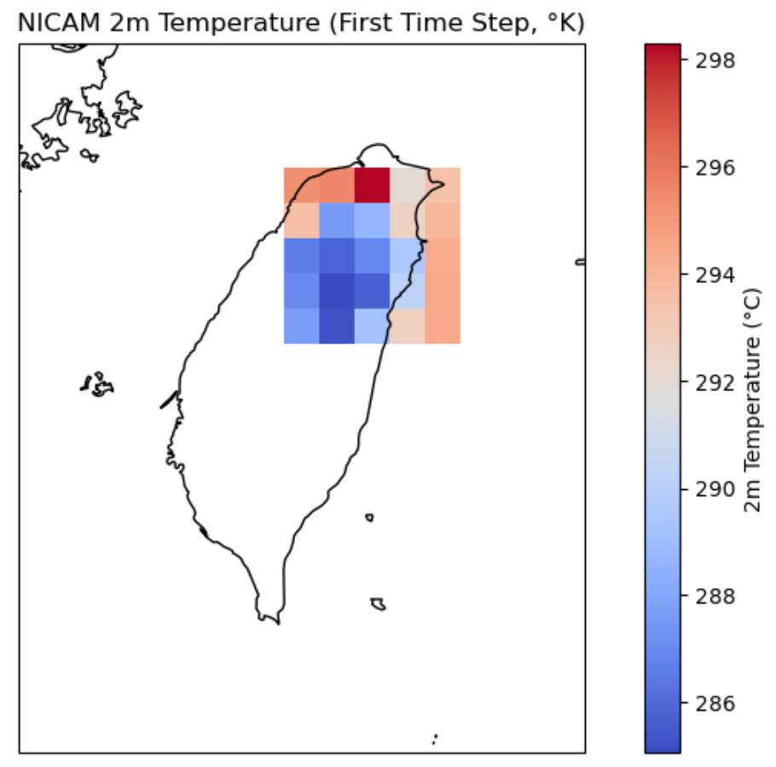
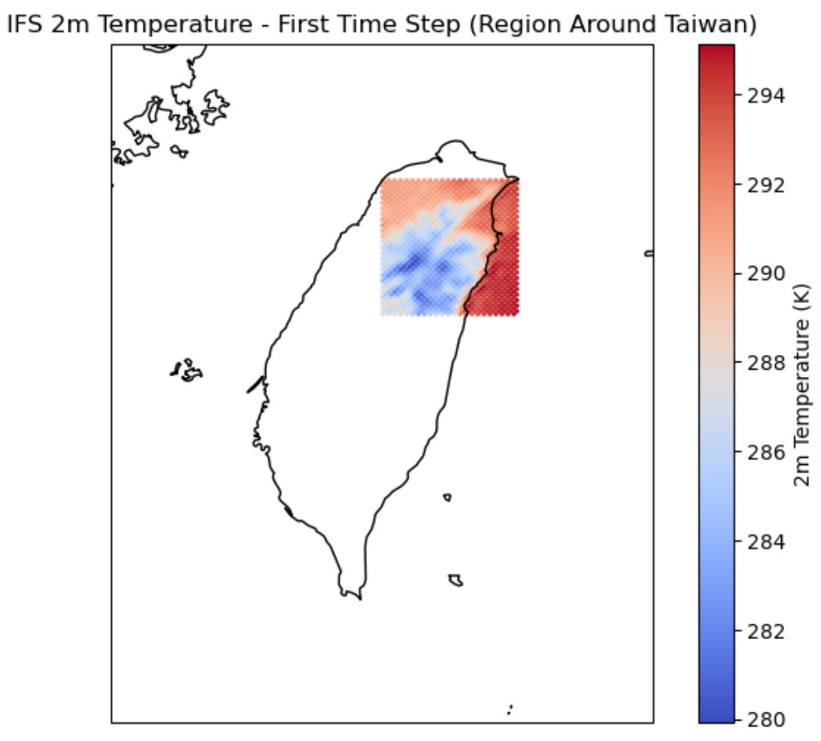
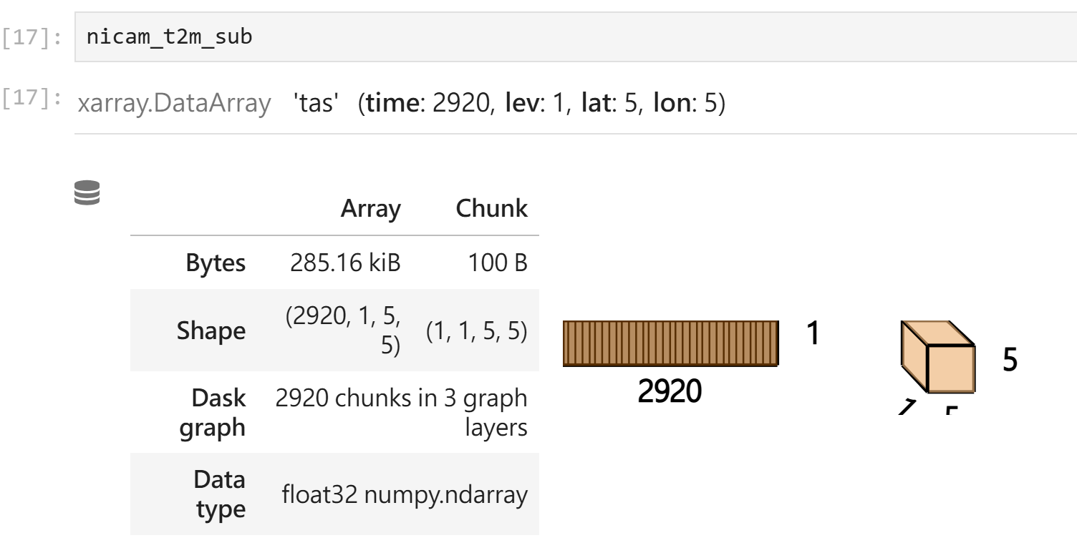
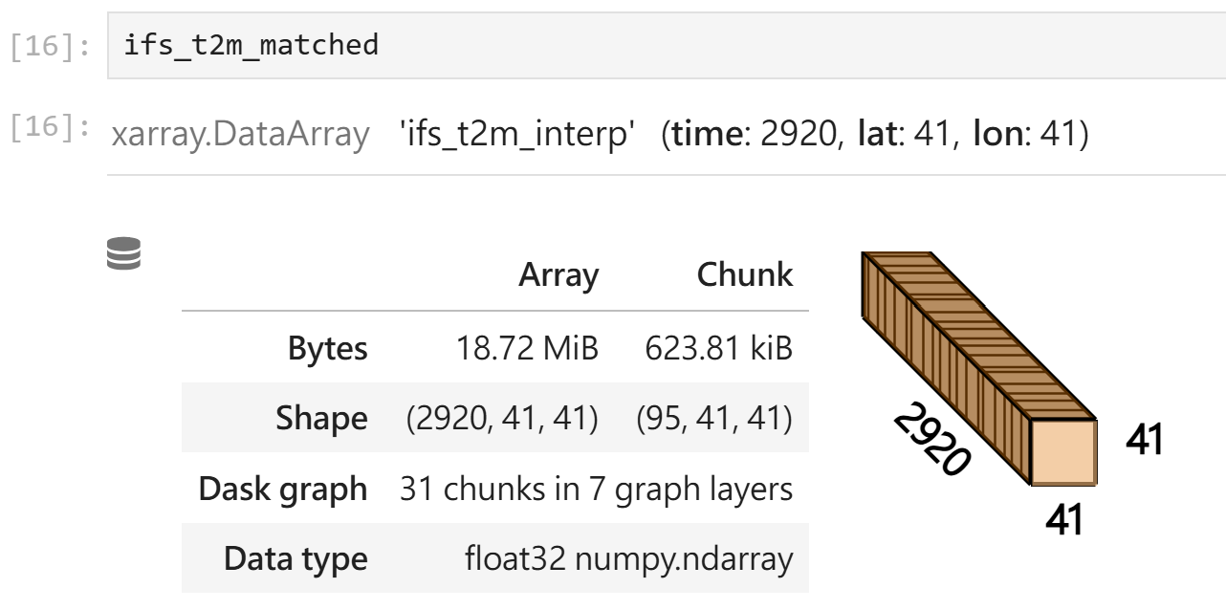
Model Design: CNN Downscaling
LR
HR
Convolutional Neural Network (CNN)
（ lat ）：24°N ~ 25°N
（ lon）：121°E ~ 122°E
（ lat ）：24°N ~ 25°N
（ lon）：121°E ~ 122°E

Slide 7
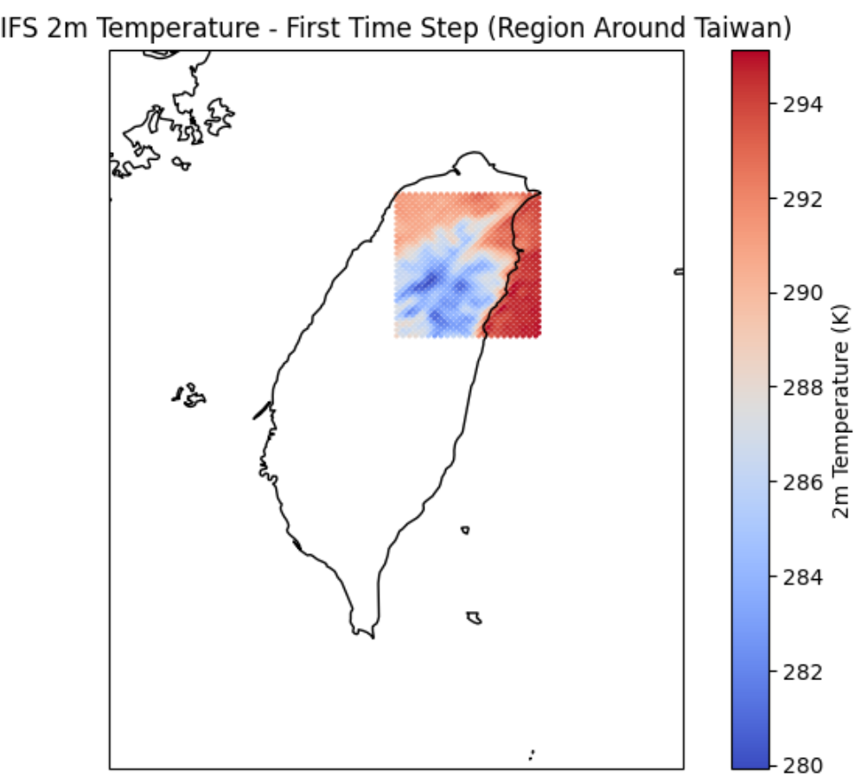
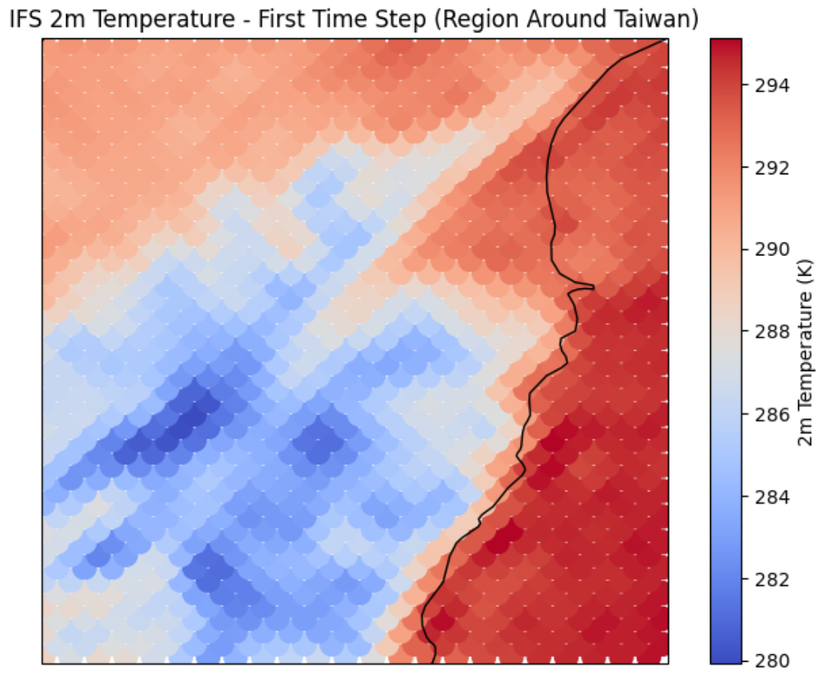
HEALPix Grid
HR

Slide 8
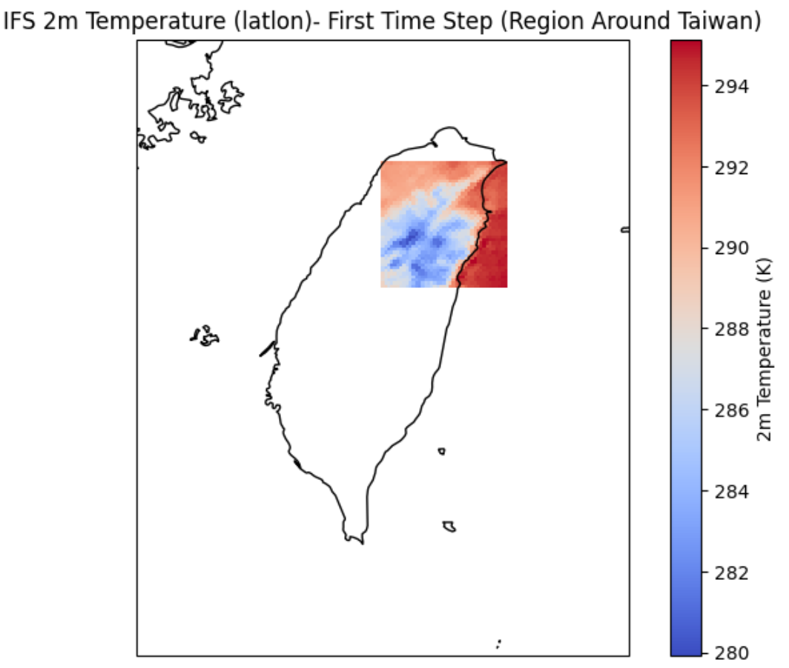
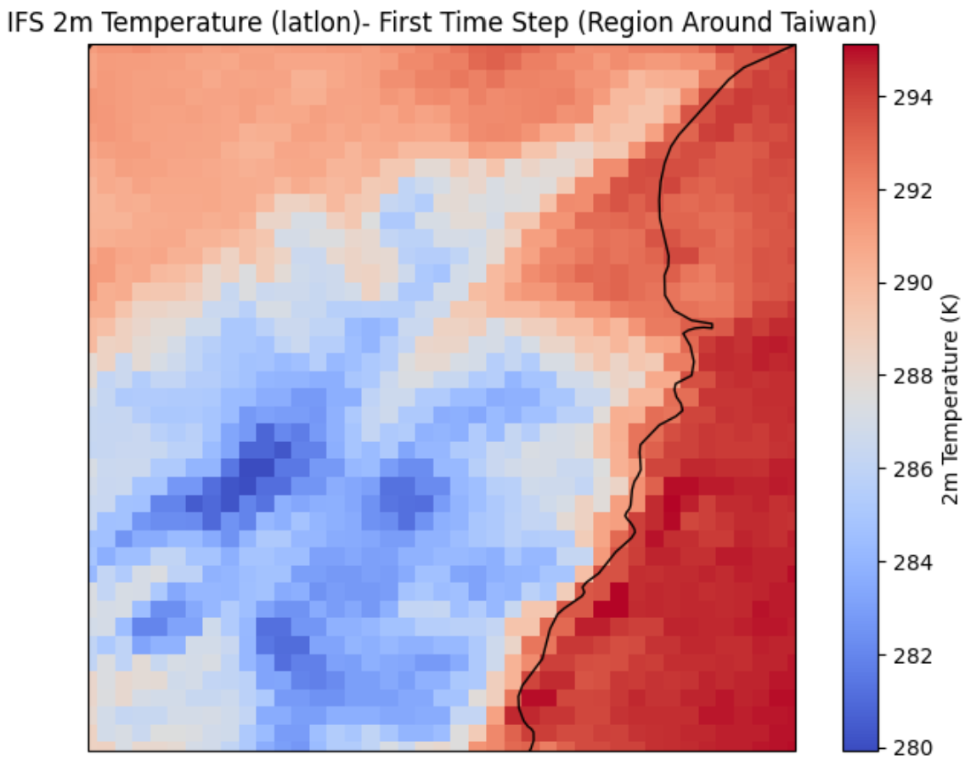
Lat-Lon Grid
HR

Slide 9
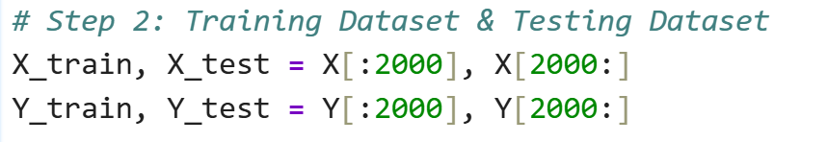
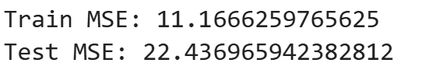
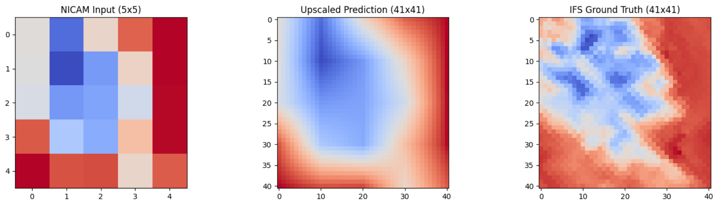
Model Training and Evaluation
Baseline Test

Slide 10
Thank you for listening.

